Slide 1

Picking the right Vehicle for a Taxi Company
Group 2 Joe Acanfora, Jeff Morris Sean Cordrey and Jae Choi

Slide 2
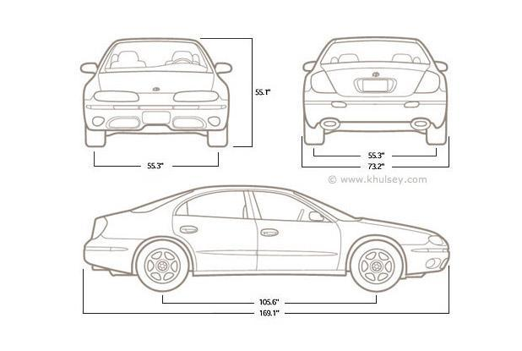

Motivation
Help a taxi company pick the best vehicle
Consideration:
Size
Fuel Economy
Transmission

Slide 3
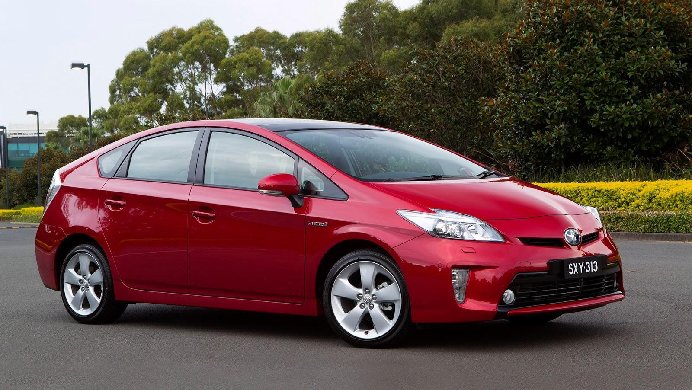
Results - Hybrid
2015 Toyota Prius
94 Cubic Feet
72 city mpg
MSRP: $24,200

Slide 4
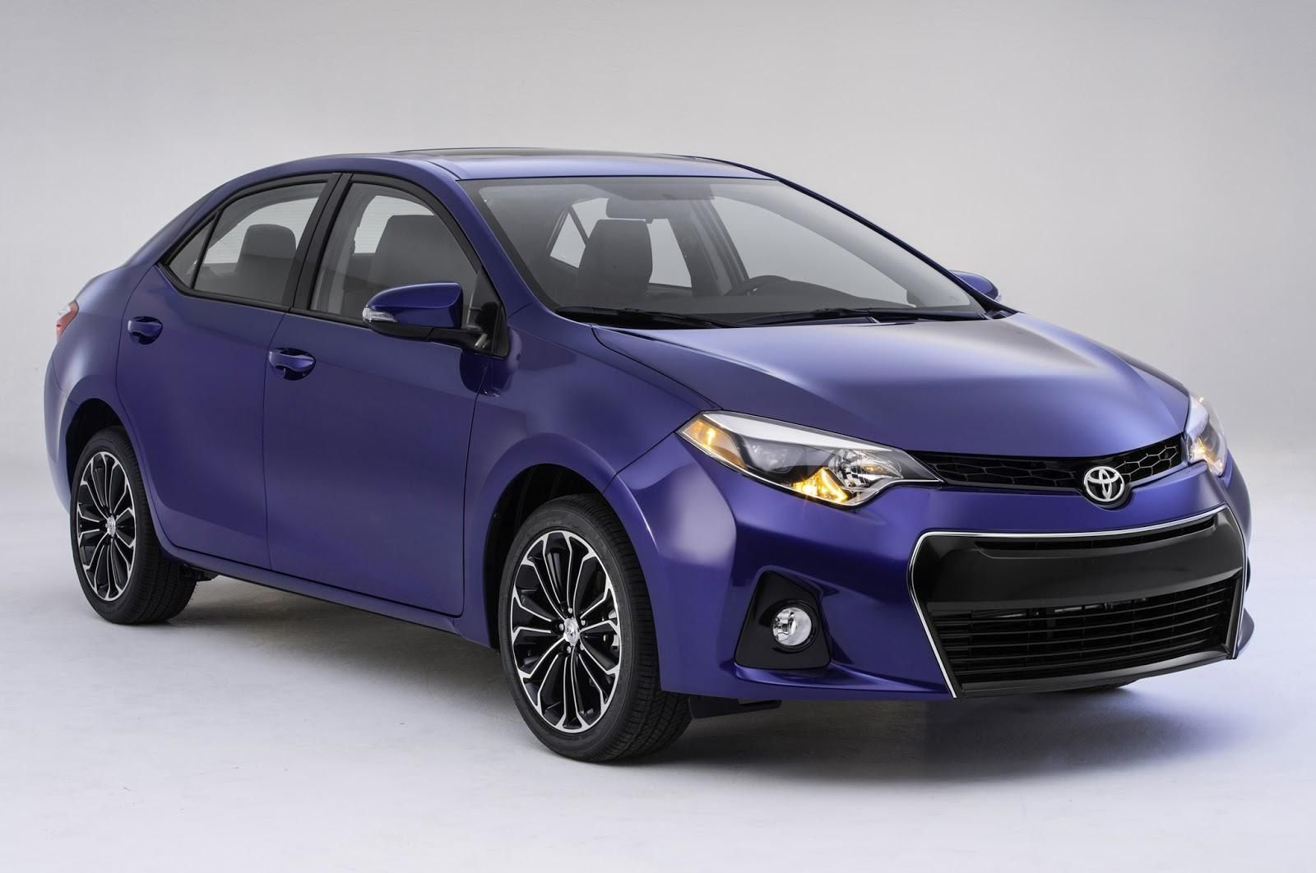
Results
2014 Toyota Corolla
98 cubic feet
40 city mpg
$22,970

Slide 5

Results - Large Vehicles
2011 Honda Odyssey
148 cubic feet
24 city mpg
Original MSRP: $28,975
Current Value $15,456

Slide 6

Data Sources and Numerical Summaries
Data Source
Vehicles.csv from (http://catalog.data.gov/dataset/fuel-economy-data)
From the Department of Energy
city08: Miles per gallon in a city
min: 6.00
1st Qu. 15.00
Median: 17.00
Mean: 17.64
3rd Qu. 20.00
Max. :138
VClass: (Vehicle Class)
Compact Cars : 5116
Subcompact Cars : 4615
Midsize Cars : 3974
Standard Pickup Trucks : 2354
Sport Utility Vehicle - 4WD: 2090
Two Seaters : 1723
(Other) :15536
fuelType:
Regular: 6087
Premium: 3950
Gasoline or E85: 957
Diesel: 179
Premium or E85: 72
Midgrade: 48
other: 20

Slide 7
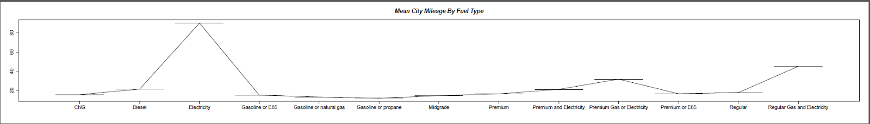
Mean City Mileage By Fuel Type

Slide 8
 | row.names | fuelType | city08
1 | 3 | Electricity | 89.95588
2 | 13 | Regular Gas and Electricity | 45.10000
3 | 10 | Premium Gas or Electricity | 31.80000
4 | 2 | Diesel | 21.46584
5 | 9 | Premium and Electricity | 21.20000
6 | 12 | Regular | 17.79828
7 | 11 | Premium or E85 | 16.69697
8 | 8 | Premium | 16.53334
9 | 1 | CNG | 15.77966
10 | 4 | Gasoline or E85 | 15.11765
11 | 7 | Midgrade | 14.68750
12 | 5 | Gasoline or natural gas | 13.33333
13 | 6 | Gasoline or propane | 12.00000

Slide 9
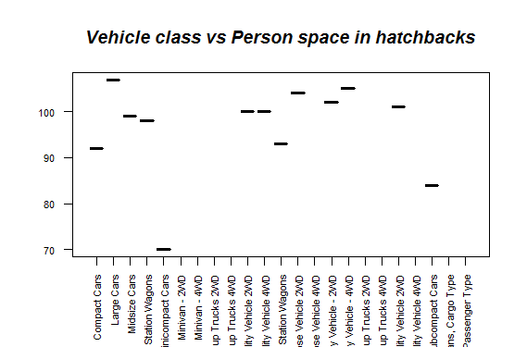

Slide 10
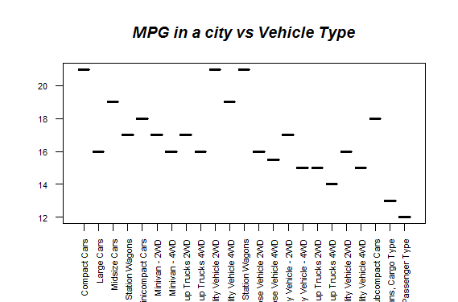

Slide 11
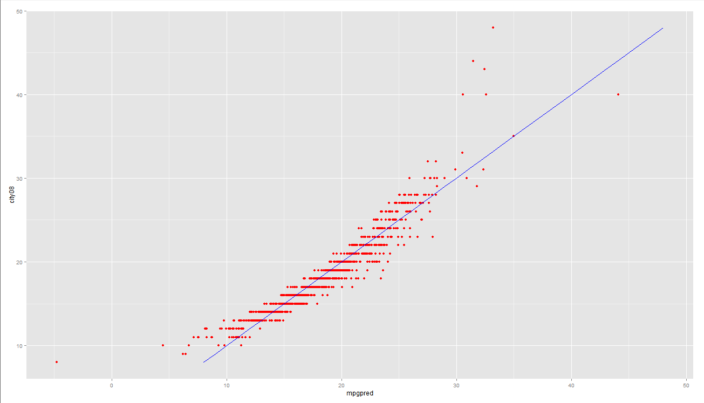
Linear Regression
Using Make, Vehicle Class, Fuel Type, Number of Cylinders, the drive and transmission type as features in determining City MPG.

Slide 12
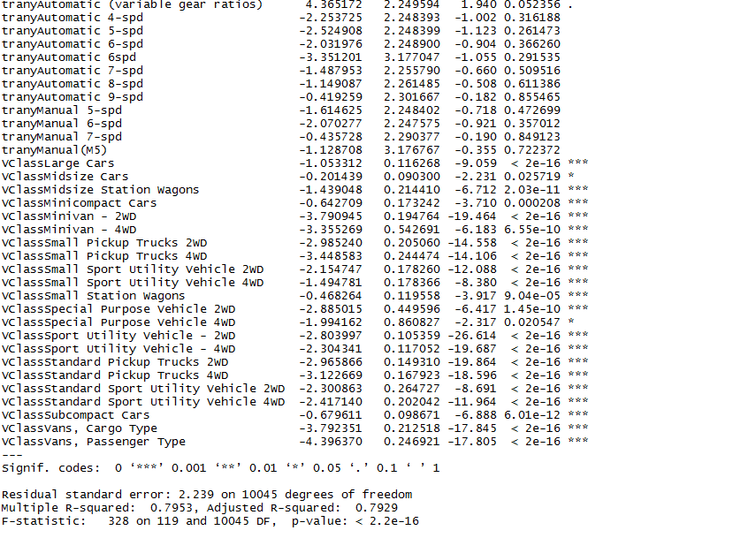

Slide 13
Analysis of Significant Factors
Make: Not much insight, most contribute significantly to MPG, with makes that have high end sports vehicles not meeting significances.
Drive: None are statistically significant
Number of Cylinders: Significant with a negative coefficient
Fuel Type: All significant except for [premium and electricity] and [premium or electricity]. Significant factors have negative coefficients with Midgrade and Regular having the largest coefficients (not in magnitude, less negative).
Transmission Type: Only a few automatic types are significant with an overall positive coefficient.
Vehicle Class: All are significant. We eliminate some of these though due to lack of necessary space.

Slide 14
Deployment/Recommendation
There are circumstances and constraints to evaluate when considering which
car to purchase. Our recommendations are specific and may not be suitable for a
particular company. In these cases the most important components to consider are:
The number of cylinders: optimally around 4 to 6
Drive: 2 wheel being better than 4 and front drive being even better
Vehicle Class: Midsize or Station Wagon
Transmission: Automatic
Fuel Type: Regular or [Regular and Electricity]

